Slide 1
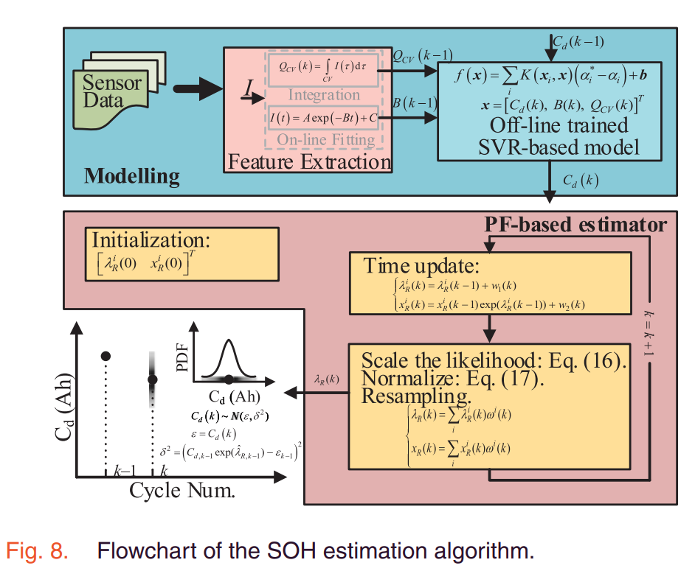





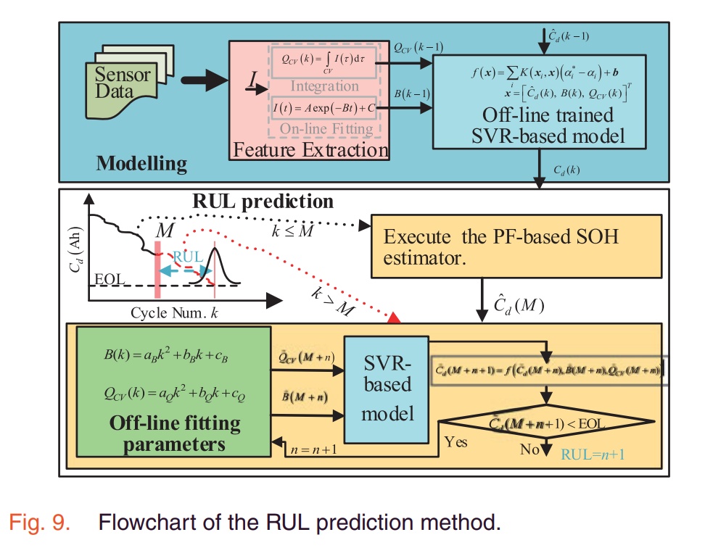
电池阵列
温度监测
实时温度分布
设定
温度
冷却系统
多电池系统建模
MPC控制器设计
控制器输出
非线性传热模型
跟踪设定温度
冷却液流量速率
线性离散模型
减少温度极差
空调系统功率

Slide 2
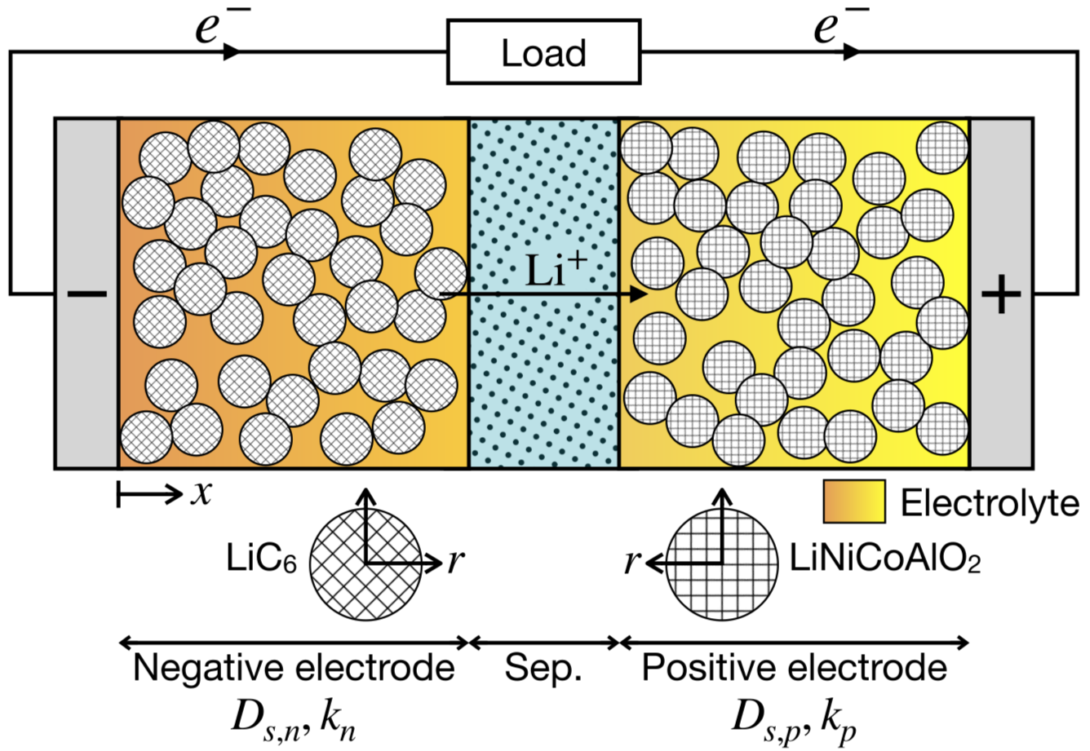



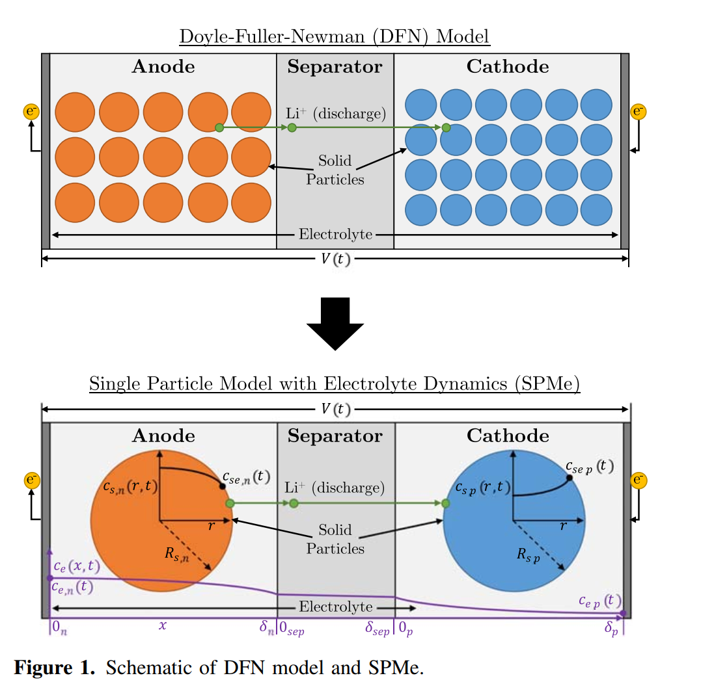






Load
Anode
Separator
Cathode
Solid
Particles
Negative electrode
Sep.
Positive electrode

Slide 3
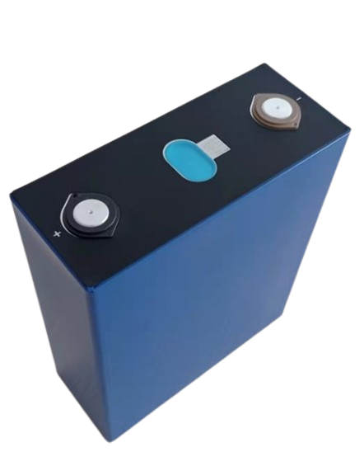
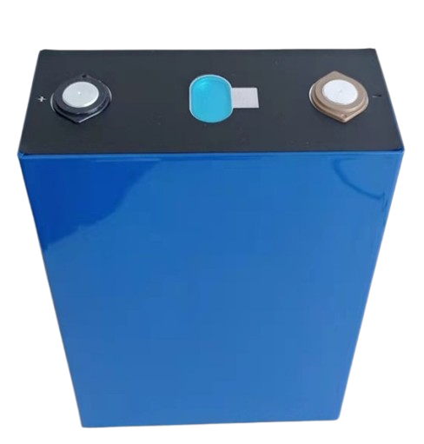
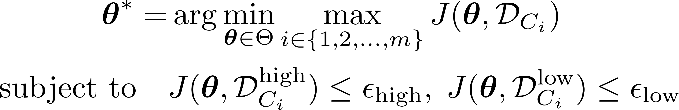
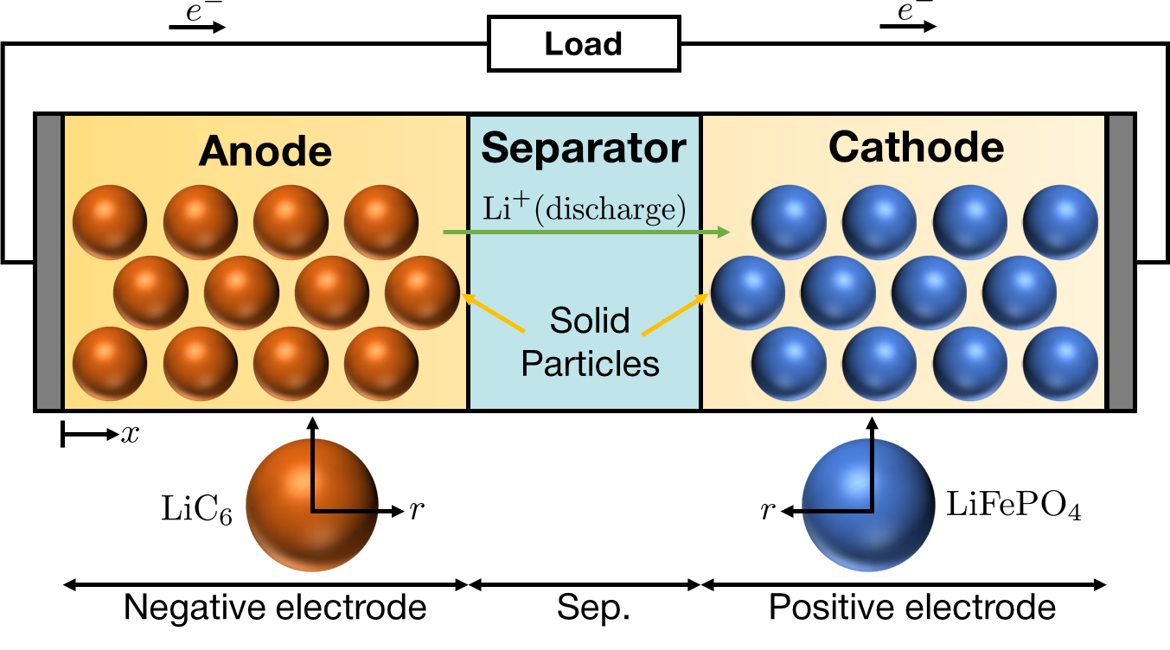
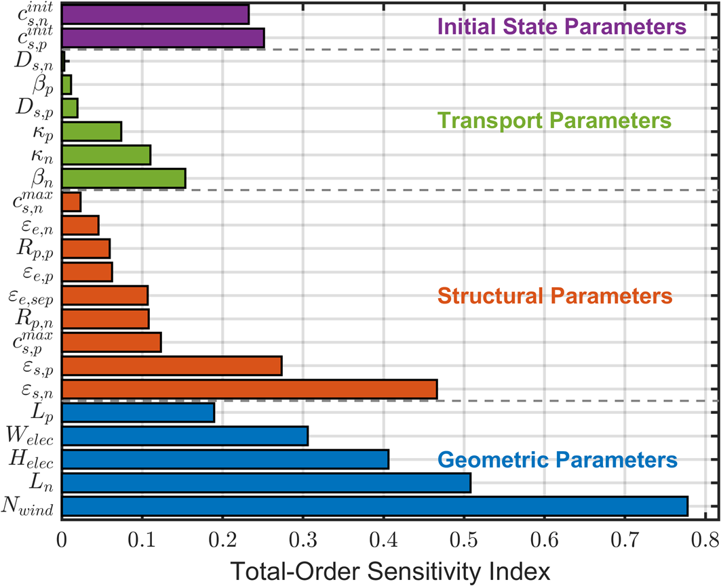
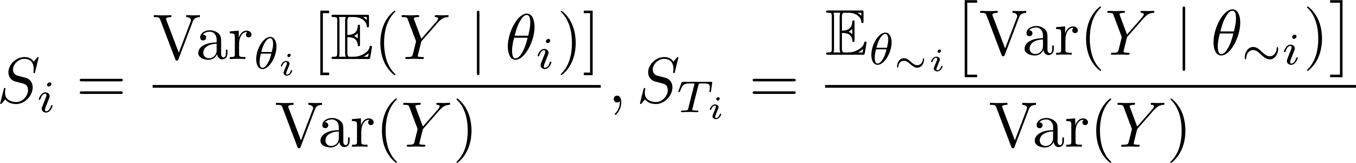


DFN Battery Modeling with Real Discharge Data
Region-Aware Min-Max Formulation
Experiment
Simulation
Large-format Battery
DFN Modeling
Low-SOC Region
Voltage (V)
High-SOC Region
Data
Time (s)
280 Ah
Trust Region based Constrained Bayesian Optimization
Gaussian Process Regression
Cross-condition Sensitivity Analysis
Trust Region Management
Sobol Indices
Granular-Adaptive Local Search
SEARCH Stage
IF FAIL
FINALIZE Stage
Weighted Error Criterion

Slide 4
载荷
阴极
分隔界面
阳极
固态颗粒

Slide 5
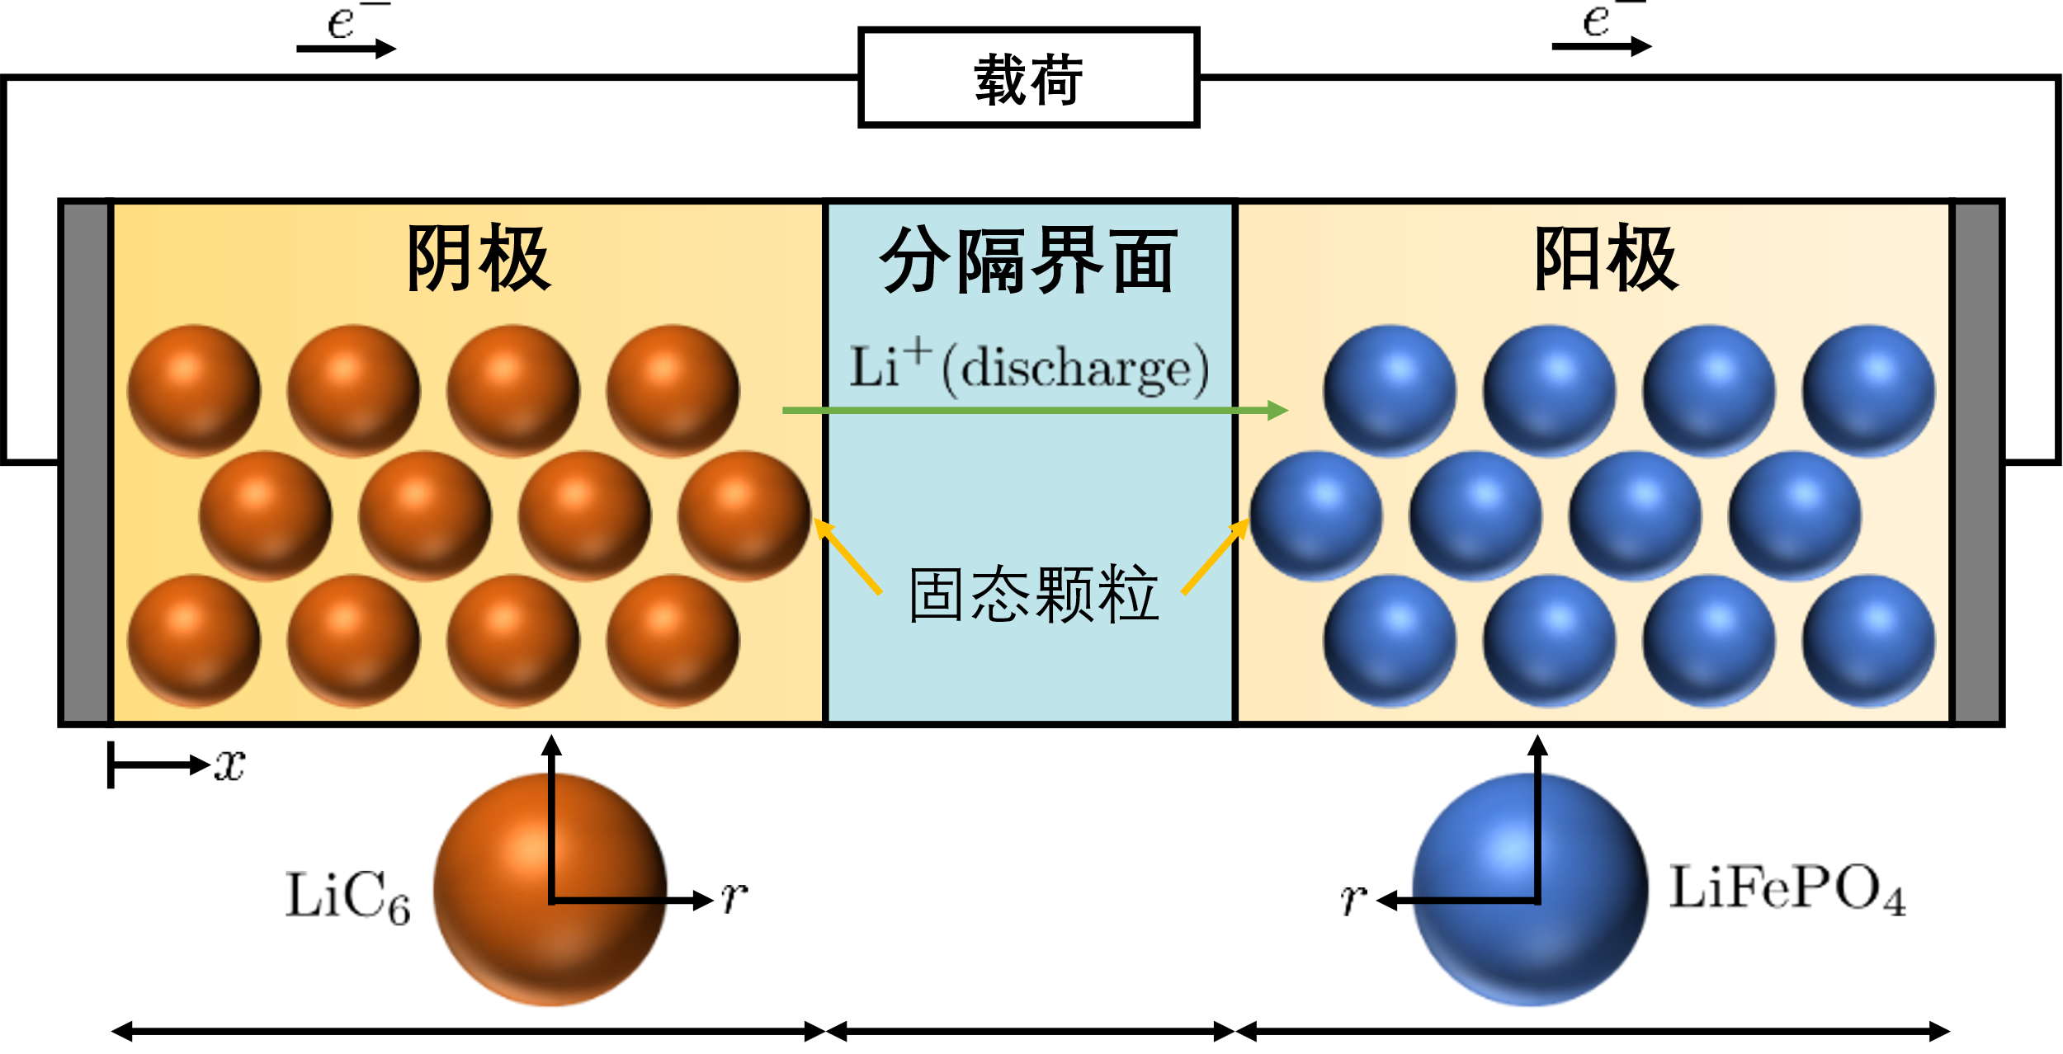
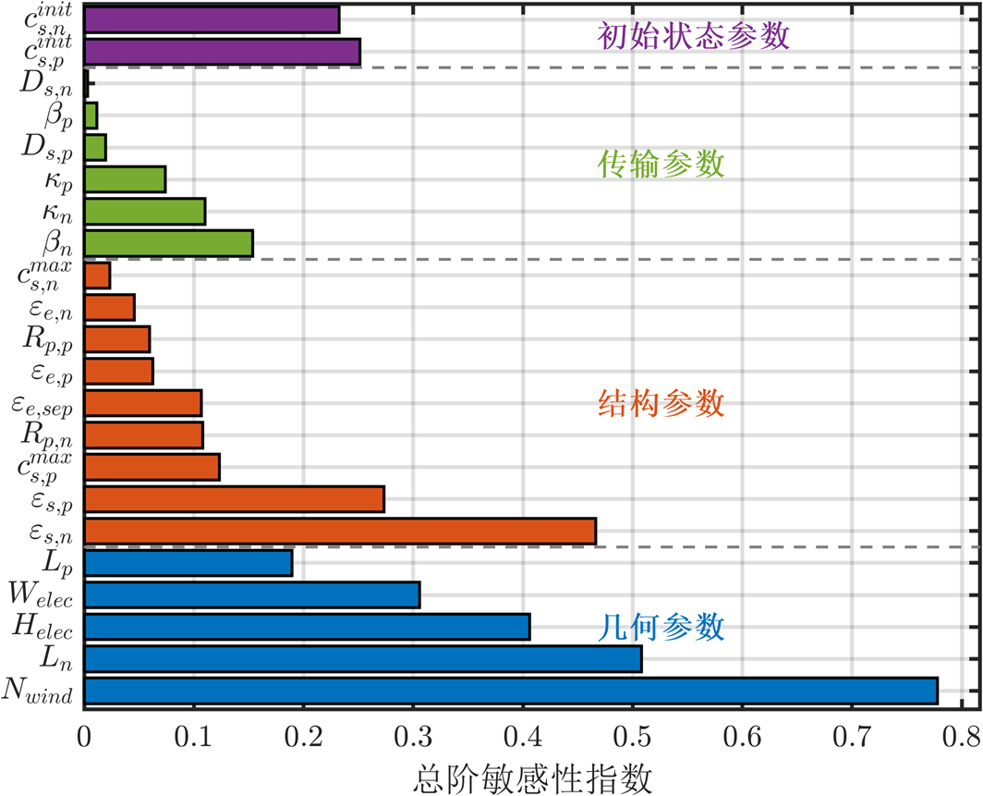
基于实际放电数据的DFN电池建模与参数敏感性分析
基于关键区域约束的优化目标函数
Experiment
Simulation
大容量锂离子电池
DFN 建模
Voltage (V)
Low-SOC Region
High-SOC Region
数据
Time (s)
280 Ah
基于信任域的约束贝叶斯优化
高斯过程回归
跨工况敏感性分析
信任域管理
Sobol指数
粒度自适应局部搜索算法
搜索阶段
IF FAIL
最终阶段
加权误差

Slide 6
DFN Battery Modeling with Real Discharge Data
Region-Aware Min-Max Formulation
Experiment
Simulation
Large-format Battery
DFN Modeling
Low-SOC Region
Voltage (V)
High-SOC Region
Data
Time (s)
280 Ah
Trust Region based Constrained Bayesian Optimization
Gaussian Process Regression
Cross-condition Sensitivity Analysis
Trust Region Management
Sobol Indices
Granular-Adaptive Local Search
SEARCH Stage
IF FAIL
FINALIZE Stage
Weighted Error Criterion

